Slide 1
TIES4560
Task 2
Group members:
Tiina Tuomisto
Md Tanjimuddin
Elahe Hajihashemi Varnousfaderani

Slide 2
Task 2-1
Web Service with Web API

Slide 3
Business Logic
Methods:
Add
Subtract
Divide
Multiply
Calculator (third party web service to be consumed)
Web service testing tools
(act as a client to send request to service and get the response - GUI)
Extended Calculator (more functionality that we added)
Methods:
Factorial
Modulo
Average

Slide 4
Implementation steps
Step1 (Creating our web service - ExtendedCalculator):
web dynamic project
Add class to define the methods (WebMethod annotated)
Create a web service based on the class functionality
Reach the wsdl file (generated by the web service)

Slide 5
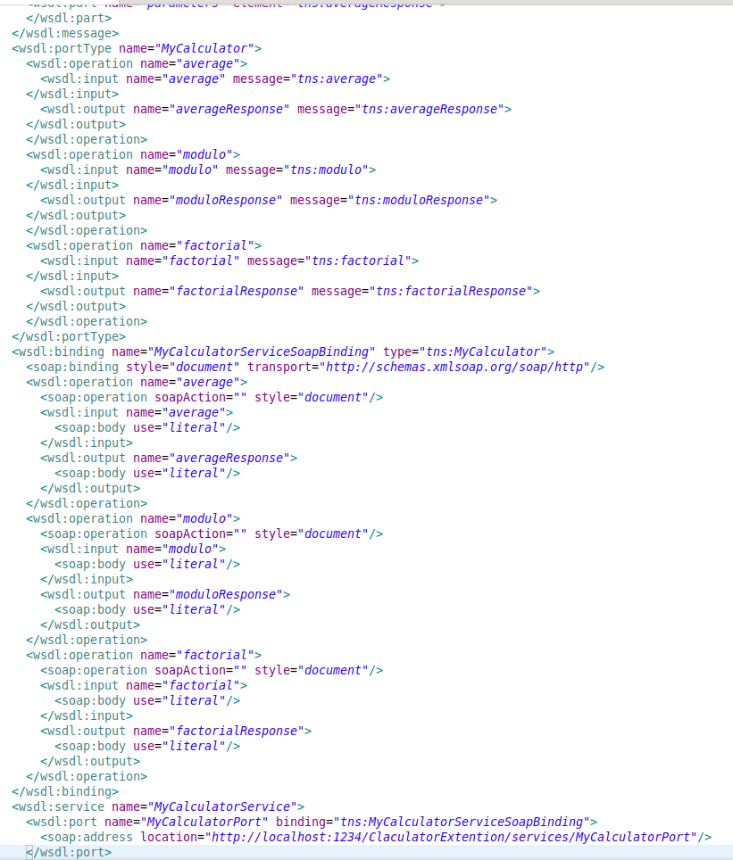
Step 1 - 4
Wsdl file containing operations and bindings

Slide 6
Implementation steps
Step 2 (consuming third party service besides our service)
Use wsdl file of remote web service (calculator) and also our web service (Extendedcalculator) to generate java files using wsimport
Add all files to a new project

Slide 7
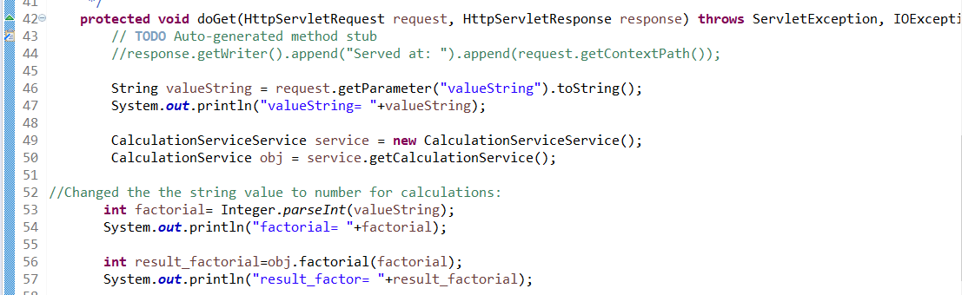
Implementation steps
Step 3
Create servlet to make request and call the methods of the final web service

Slide 8
Our Webservice:
path | method | parameters | response | failure
/calculateFactorial | GET | valueString | Response code 200 and the result of factorial function for input number (JSON) | 404 exception in returning the result value + Error message
/calculateAverage | GET | valueString valueStringTwo | Response code 200 and the result of average (JSON) | 404 exception in returning the result value + error message
/calculateModulo | GET | valueString valueStringTwo | Response code 200 and the result of modulo (JSON) | 404 exception in returning the result value + error message’

Slide 9
Thirdparty and other functionalities:
path | method | parameters | response | failure
/calculateMultiply | GET | valueString valueStringTwo | Response code 200 and the result of factorial function for input number (JSON) | 404 exception in returning the result value + Error message
/calculateFactorialOfMany | POST | Data is sent in the POST body | code 302 (or 303) and redirect to /calculateFactorial?valueString=’POST_value’ | 404 exception in returning the result value + error message
/calculateAverageofMany | GET | valueString valueStringTwo valueStringThree | Always fails | response code 501 and JSON message “is not implemented”

Slide 10
Implementation steps
Step 4
Postman as web service testing tool to send request to the service and receive the response

Slide 11
Postman
Pass the input values to the service via URL

Slide 12
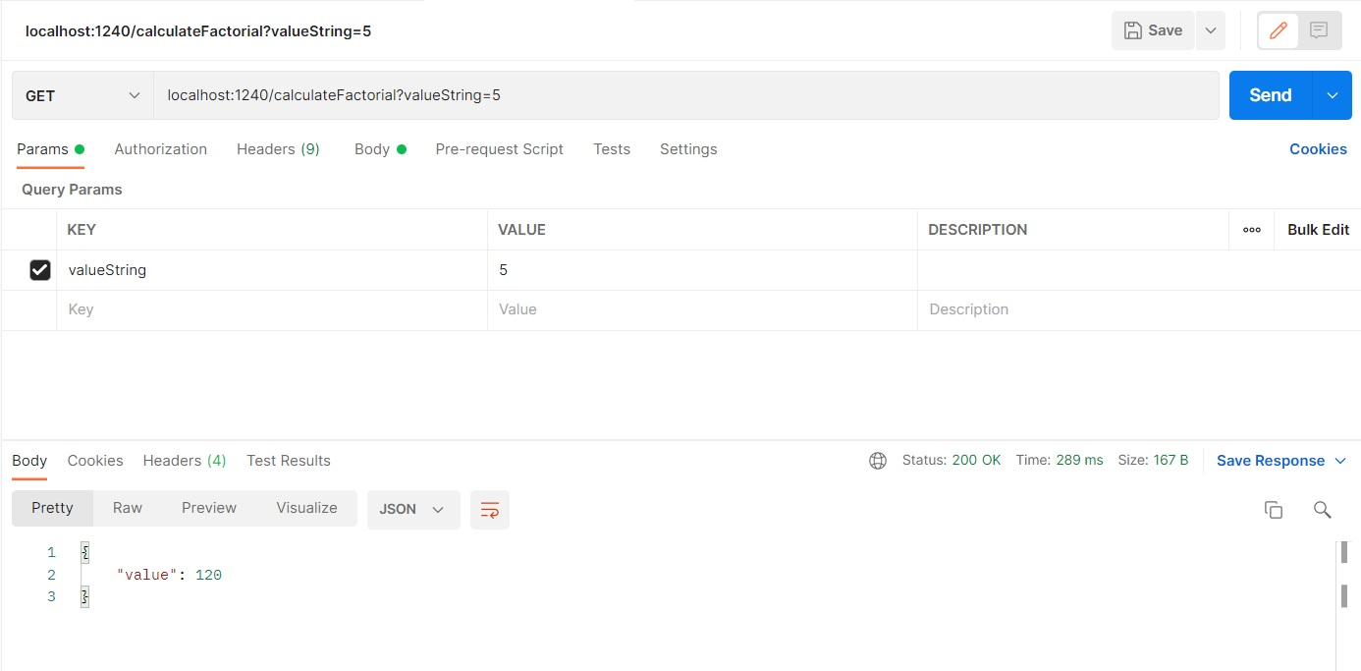
GET: Factorial

Slide 13
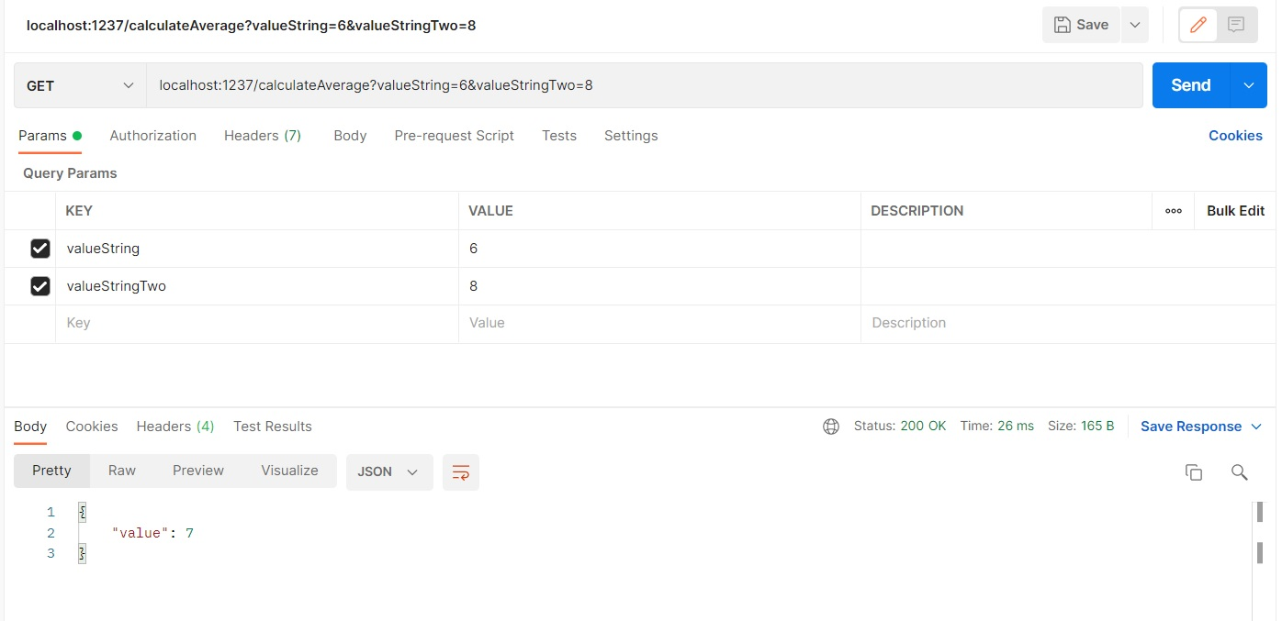
GET: Average

Slide 14
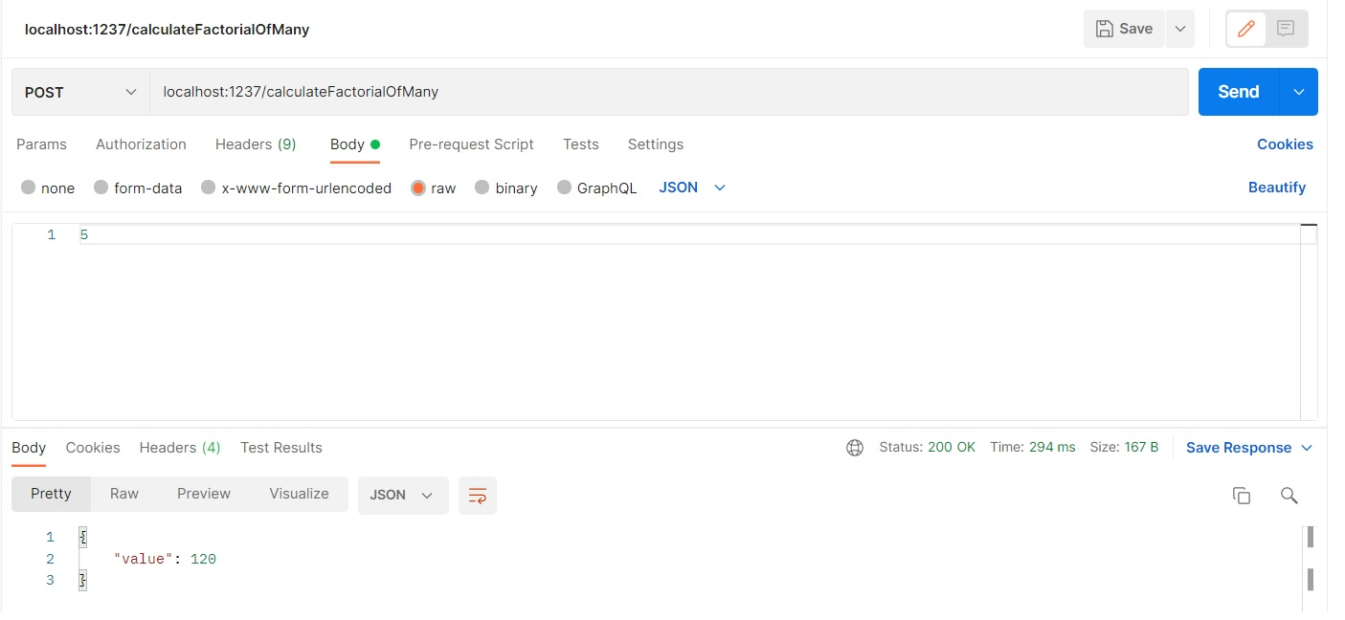
POST: Redirection FactorialOfMany

Slide 15
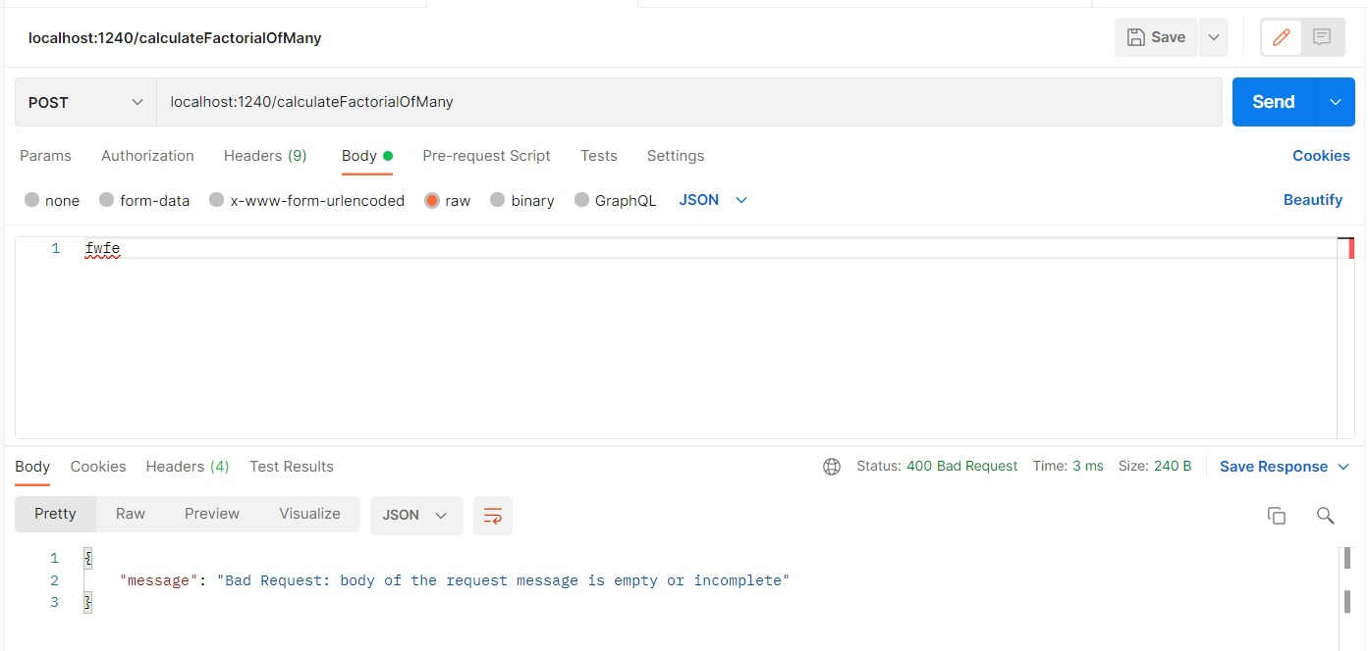
POST: Redirection FactorialOfMany

Slide 16
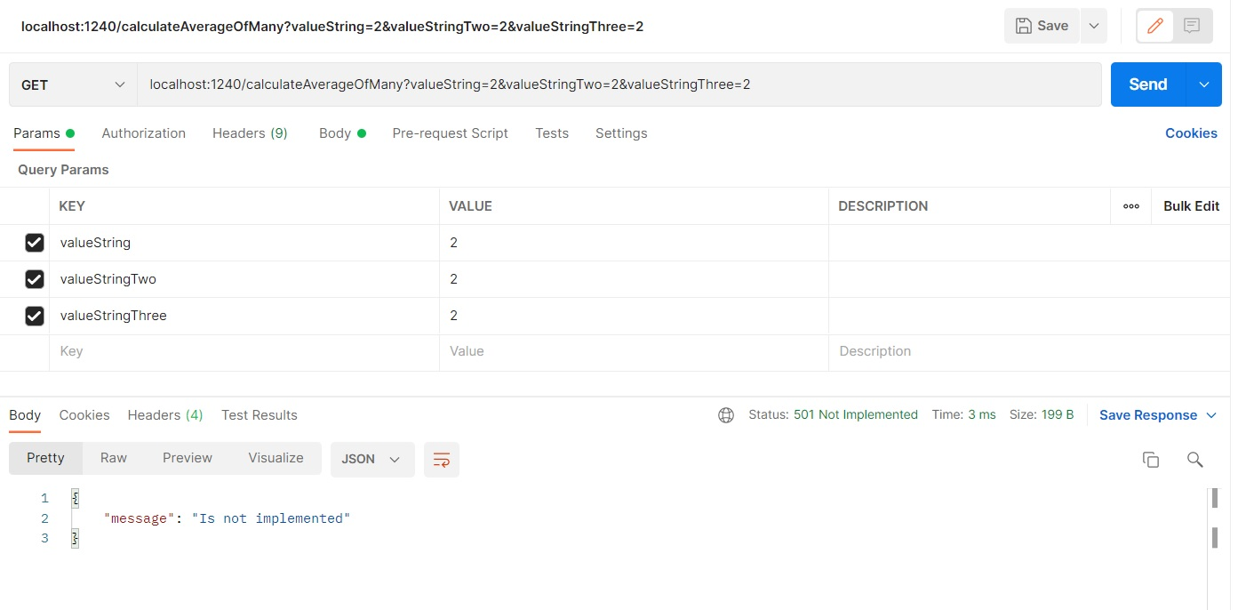
GET: Not Implemented AverageOfMany

Slide 17
Task 2-2
A Simple REST Client Exercise

Slide 18
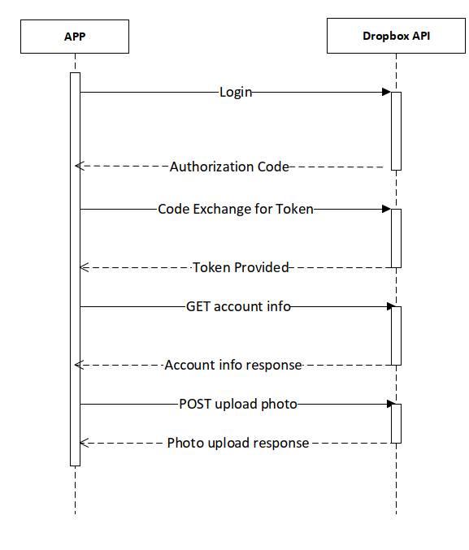
Dropbox access flow

Slide 19
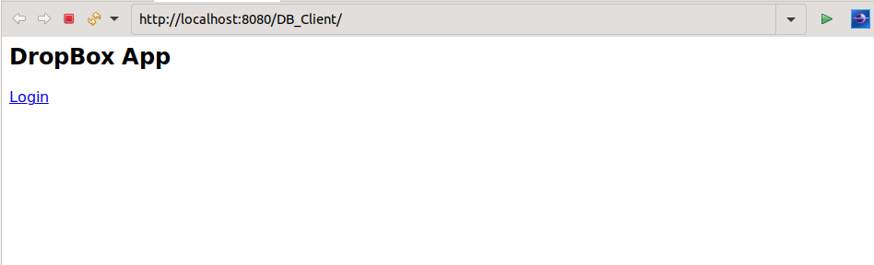
Login to dropbox from client

Slide 20
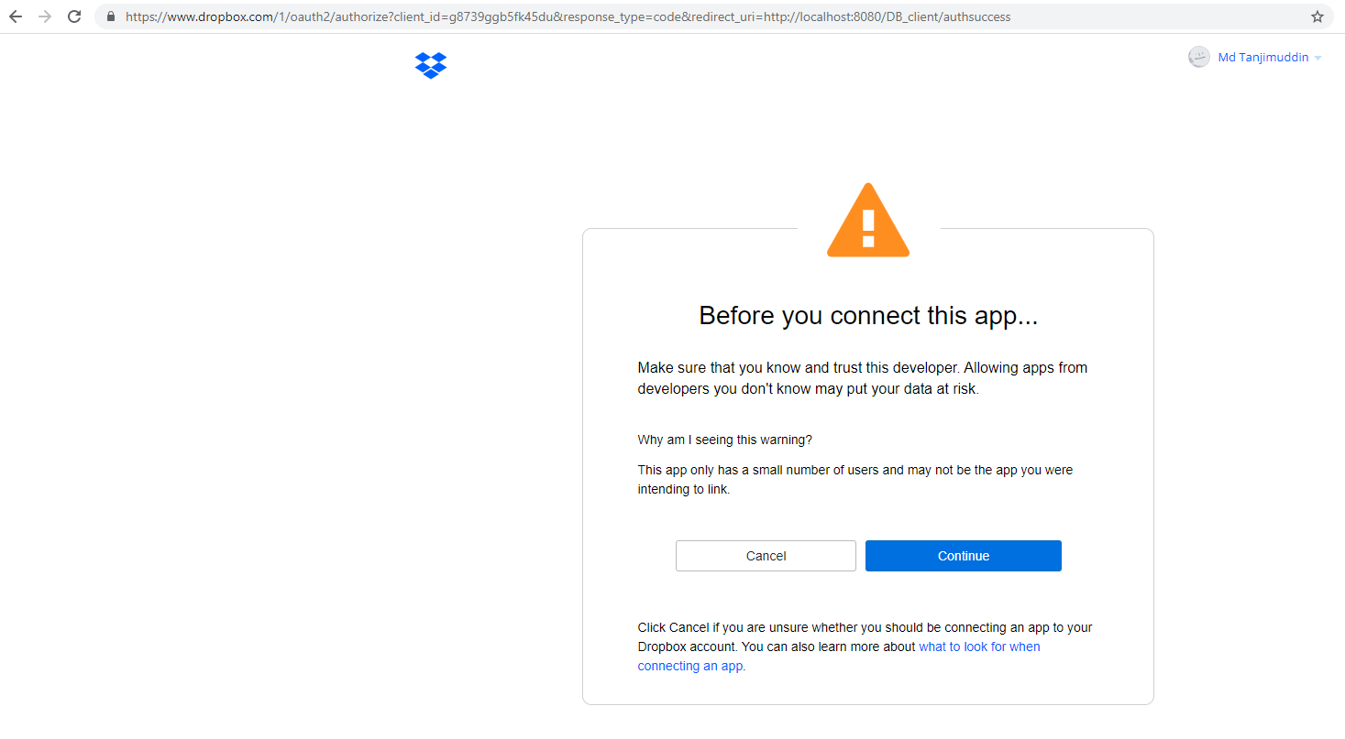
Login to dropbox from client

Slide 21
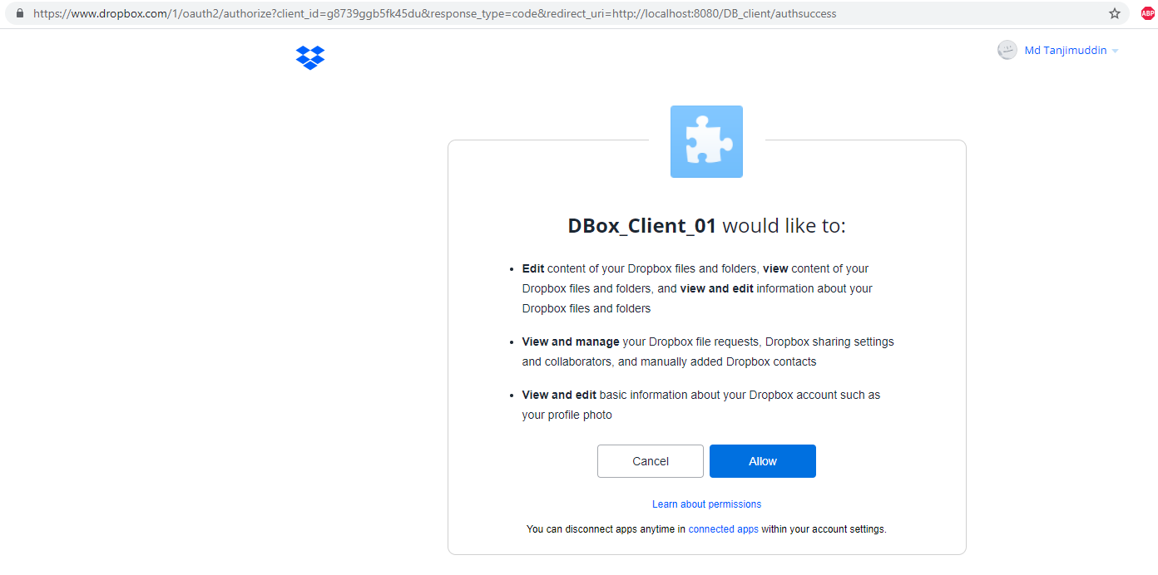
Login to dropbox from client

Slide 22
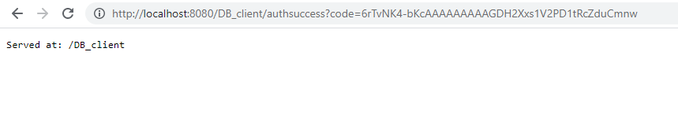
Code from the dropbox

Slide 23
Thank You

